Slide 1
RISK ASSESSMENT TRAINING
David Cutri, Internal Audit and Compliance

Slide 2
AGENDA
Enterprise Risk Management
Risk Analysis/Risk Assessment

Slide 3
ENTERPRISE RISK MANAGEMENT

Slide 4
ENTERPRISE RISK MANAGENENT DEFINED
Enterprise risk management (ERM) in business includes the methods and processes used by organizations to manage risks and seize opportunities related to the achievement of their objectives.
  “The point of enterprise risk management is not to create more bureaucracy, but to facilitate discussion on what the really big risks are.”
  (Thomas Stanton, Johns Hopkins University)

Slide 5
AN ERM HISTORY LESSON …
Late 1980’s: Savings and Loan Crisis
  Led to Internal Control: An Integrated Framework, published by the Committee Of Sponsoring Organizations of the Treadway Commission (COSO) in 1992
Late 1990’s/Early 2000’s: Enron, WorldCom, Adelphia, Dot Coms
  Led to the Sarbanes-Oxley Act of 2002 (SOX)
2008 – 2010: Housing Bubble/Stock Market Corrections
  Led to multi-industry financial reforms

Slide 6
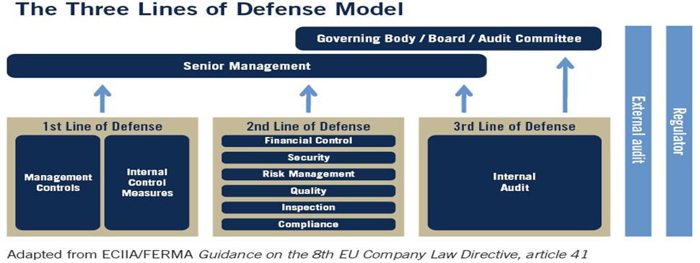

Slide 7
ENTERPRISE RISK MANAGEMENT MODELS
COSO
Casualty Actuarial Society
ISO 31000
Risk Insurance Management Society (RIMS) Risk Maturity Model
COSO is most generally-accepted internal control model/ERM framework in industry, and the one we will focus on today

Slide 8
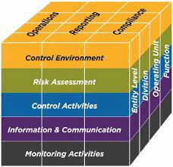
COSO CUBE/PYRAMID
Note
The shape itself (cube, pyramid, etc.) is not important.
What is important is that the shape be three-dimensional.
The image on the left applies to internal control frameworks. The image was expanded slightly in 2014 to facilitate use in Enterprise Risk Management.

Slide 9
COSO INTERNAL CONTROL/ERM MODEL
Three dimensions …
  Components of internal control
  Objectives of internal control
  Impact across divisions/locations/units

Slide 10
COSO DIMENSION #1
COMPONENTS OF INTERNAL CONTROL
Control Environment
  “tone at the top”
Risk Analysis (i.e., risk assessment)
Control Activities
  actions taken to minimize risks
Information and Communication
Monitoring
Expansions to Facilitate Use in ERM
Effective 2014
Objective Setting
Event Identification
Risk Response

Slide 11
COSO DIMENSION #2
OBJECTIVES OF INTERNAL CONTROL
Effectiveness and Efficiency of Operations
Reliability of Financial Reporting
Compliance with Applicable Laws and Regulations
Expansion to Facilitate Use in ERM
Effective 2014
Strategy - high-level goals, aligned with and supporting the organization's mission

Slide 12
COSO DIMENSION #3
Impact across divisions/locations/units
The recognition that the same practices may replicate themselves across multiple divisions, locations, units, subsidiaries, etc.
For example, the same business management practices may be replicated in the various academic departments, or floors in a hospital.

Slide 13
RISK ASSESSMENT

Slide 14
RISK ASSESSMENT DEFINED
A systematic process for identifying and evaluating events (possible risks or opportunities) that could affect the achievement of objectives (positively or negatively).
  -- The Institute of Internal Auditors
In contrast to Enterprise Risk Management, risk assessments are performed/maintained at the department/unit level.

Slide 15
WHO IN THE UNIVERSITY IS RESPONSIBLE FOR COMPLETING RISK ASSESSMENTS?
YOU !!!
(The Process Owner)

Slide 16
RISK ASSESSMENT/KEY TERMS
Business Objective
Risk
Control
Impact
Likelihood
Action Plan/Risk Management

Slide 17
BUSINESS OBJECTIVES
“What do you come in to work to do every day?”
Each process should have one or more Business Objectives associated with it (generally three to five)
THE BUSINESS OBJECTIVES SHOULD ALIGN WITH (AND NOT CONTRADICT) THE MISSION AND VISION OF THE UNIVERSITY!
Each Business Objective should have a qualitative component
Sources for identifying Busines Objectives …
    Strategic Plans
    Regulatory/Policy Requirements
    Position Descriptions
    Webpages

Slide 18
RISKS
Simply put, a “Risk” is a barrier to achieving a business objective
Each business objective should have one or more Risks associated with it (generally three to five)
General types of Risk
    Inherent Risk
    Residual Risk

Slide 19
GENERAL TYPES OF RISK
Inherent Risks – The Risks within a process/business objective, assuming no (internal) controls are in place
  i.e., “The Wild West”
Residual Risks – The remaining Risks within a process/business objective, after considering the effect of (internal) controls
  There should be far fewer Residual Risks than Inherent Risks in a process
  Put mathematically ...
      Residual Risks = Inherent Risks –
      The Impact of Controls

Slide 20
CONTROLS (AKA Internal CONTROLS)
“Internal control is a process, effected by an entity’s board of directors, management, and other personnel, designed to provide reasonable assurance regarding the achievement of objectives relating to operations, reporting, and compliance.
    -- The Institute of Internal Auditors
Each inherent risk should have one or more Controls associated with it (generally three to five)
Examples: Policies, procedures, reporting, system edits, management reviews, physical barriers, separation of duties, transaction limits ($, #), etc.
Types: Preventive, detective, corrective, automated,
manual, key, compensating, etc.

Slide 21
BACK TO RESIDUAL RISK …
As previously mentioned, Residual Risks are the remaining Risks within a process/business objective, after considering the effect of internal controls
The process owner should regularly identify and document Residual Risk (when contrasted with the inherent risk) as part of his/her risk assessment process

Slide 22
IMPACT AND LIKELIHOOD
Impact – The estimated exposure of a residual risk, should it manifest itself
  Measured in financial, operational, reputational terms, etc.
  Does not have to be specific -- i.e., can be H/M/L, 1 – 5, etc.
Likelihood – The chances that a residual risk will have the Impact identified
  Does not have to be specific -- i.e., can be H/M/L, 1 – 5, etc.
  Can choose to estimate Likelihood in terms of percentage terms
The process owner’s estimate of Impact and Likelihood will allow him/her to prioritize risk management efforts

Slide 23
ACTION PLAN/Risk MANAGEMENT
Guided by impact and likelihood, the process owner is empowered to develop Action Plans to manage areas of highest risk
Components of an effective Action Plan
  Tangible/Actionable corrective tasks
  Responsible party(ies)
  Target implementation dates (make them achievable)

Slide 24
RISK MANAGEMENT/
ACTION PLAN STRATEGIES
Classic risk management acknowledges 4 ways of dealing with risk:
Avoid
Reduce
Transfer
Retain or Accept
Possible others: Exploit, Ignore

Slide 25
DOCUMENTING YOUR RISK ASSESSMENT
The detailed nature of the risk assessment process lends itself to being documented and refreshed on a recurring basis
The “one-to-many” nature of the components of risk assessment (i.e., process, business objective, inherent risks, controls, etc.) suggests that a tabular or outline formats are effective methods for documenting
An example risk assessment of a disability services process (tabular) was provided as illustration.

Slide 26
CLOSING
The goal of our session was to cover the essential terminology of risk and control, and to provide an overview of commonly used risk and control frameworks.
Examples of how to critically evaluate risks for your unit were also provided.
An example risk assessment of a disability services process was provided as illustration.

Slide 27
Questions?
David Cutri
Chief Audit Executive and Chief Compliance Officer

